Slide 1



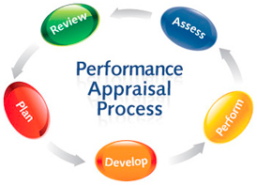

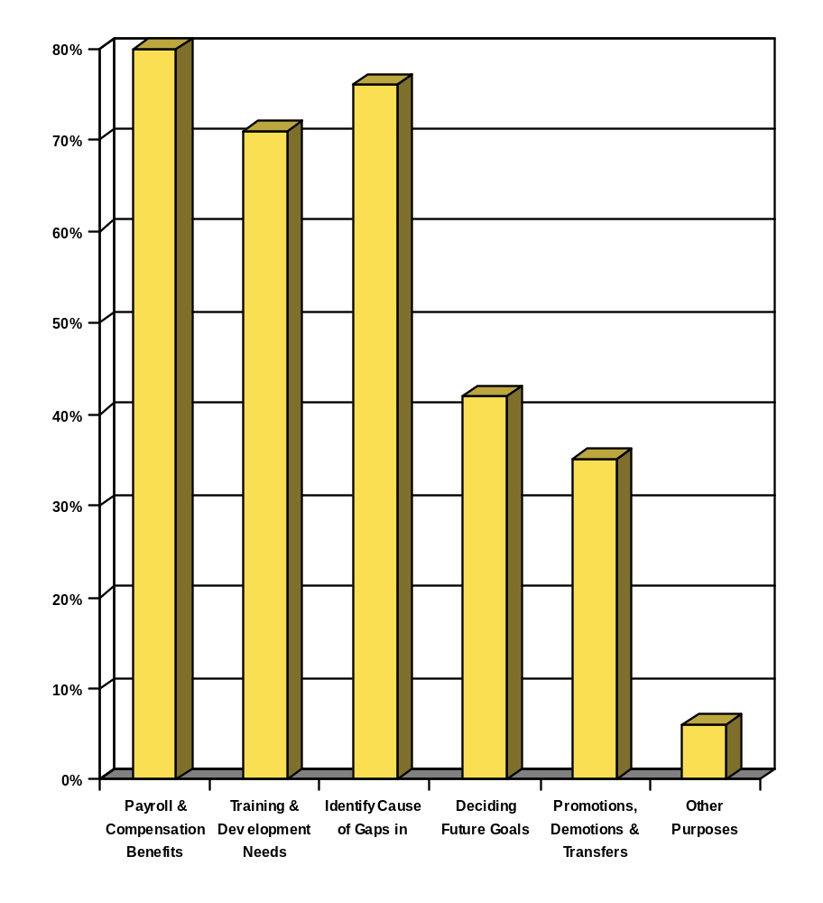










UNETHICAL PRACTICES IN PERFORMANCE EVALUATION AFFECTS THE EMPLOYEE’S PERFORMANCE
Prepared by : Uzma Aqeel REG : MB-02-07-52282 Project Supervisor : Mr. Atta-ur-Rehman Programme : MBA (HRM)
Purposes of Performance Appraisal
Methodology
80%
76%
Introduction
Research was done in one of the largest insurance company of Pakistan (AICL).
Sample size: 50 respondents
Data collection: Through questionnaires that consist of closed ended questions
Statistical tool: Regression analysis method
71%
The purpose of this research is to find out how the unethical practices and negligence in the performance evaluation of the employees affects their performances on job.
42%
35%
6%
Conclusion
The statistical results have shown that the turnover
intentions increases when the employee does not
receive the fair appraisal and their Motivation level
is affected, which ends up in the decline of the
organization’s productivity.
Hypothesis
Hypothesis one:-
H₁: There is a relationship between the Performance management and the productivity of workforce.
Hypothesis two:-
H₁: Negligence in performance evaluation inculcates the feeling of unfair treatment among the employees
Hypothesis three:
H₁: Unethical practices in performance management increase the
turnover intentions among the employees.
Hypothesis four
H₁: Performance appraisal has an effect on the motivation level of the employee.
Recommendations
Human Resource
department and appraisers
should consider performance
appraisal mainly as a mean
for development and
motivation
For the evaluation process to be effective it must be:
Honest Specific
Behavior oriented Constructive

